Slide 1
Data Mining
Lecture Notes for Chapter 4
Artificial Neural Networks
Introduction to Data Mining
by
Tan, Steinbach, Karpatne, Kumar

Slide 2
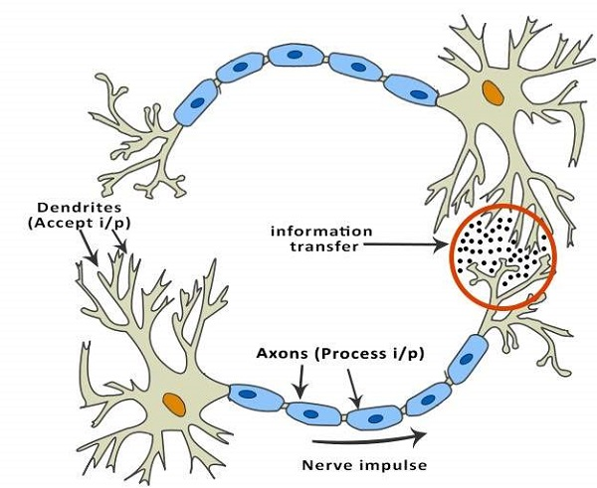
What are Artificial Neural Networks (ANNs)?
The idea of ANNs is based on the belief that working of human brain by making the right connections, can be imitated using silicon and wires as living neurons and dendrites.
The human brain is composed of 86 billion nerve cells called neurons.
They are connected to other thousand cells by Axons.
Stimuli from external environment or inputs from sensory organs are accepted by dendrites. These inputs create electric impulses, which quickly travel through the neural network. A neuron can then send the message to other neuron to handle the issue or does not send it forward.

Slide 3
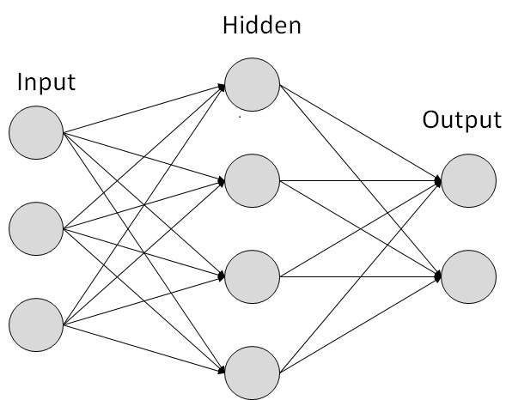
What are Artificial Neural Networks (ANNs)?
ANNs are composed of multiple nodes, which imitate biological neurons of human brain. The neurons are connected by links and they interact with each other. The nodes can take input data and perform simple operations on the data.
The result of these operations is passed to other neurons. The output at each node is called its activation or node value.
Each link is associated with weight. ANNs are capable of learning, which takes place by altering weight values. The illustration shows a simple ANN.

Slide 4
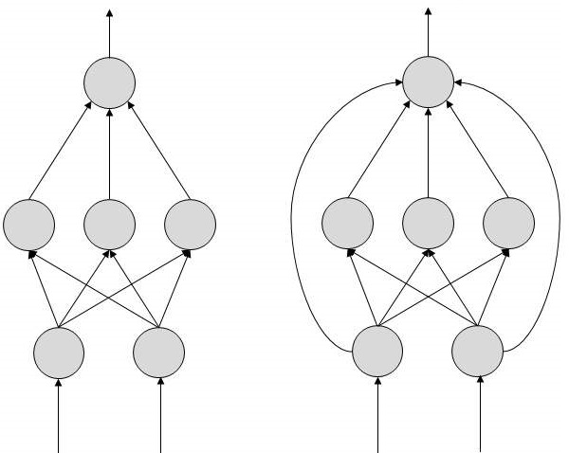
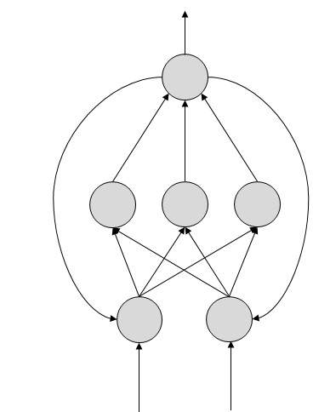
Types of Artificial Neural Networks (ANNs)?
FeedForward ANN
The information flow is unidirectional. A unit sends information to other unit from which it does not receive any information. There are no feedback loops. They are used in pattern generation/ recognition/ classification. They have fixed inputs and outputs.
FeedBack ANN
Here, feedback loops are allowed. They are used in content addressable memories.

Slide 5
Types of Artificial Neural Networks (ANNs)?
Working of ANNs
In the topology diagrams shown, each arrow represents a connection between two neurons and indicates the pathway for the flow of information. Each connection has a weight, an integer number that controls the signal between the two neurons.
If the network generates a “good or desired” output, there is no need to adjust the weights. However, if the network generates a “poor or undesired” output or an error, then the system alters the weights in order to improve subsequent results.

Slide 6
Machine Learning in ANNs
ANNs are capable of learning and they need to be trained. There are several learning strategies −
Supervised Learning − It involves a teacher that is scholar than the ANN itself. For example, the teacher feeds some example data about which the teacher already knows the answers. For example, pattern recognizing. The ANN comes up with guesses while recognizing. Then the teacher provides the ANN with the answers. The network then compares it guesses with the teacher’s “correct” answers and makes adjustments according to errors.
Unsupervised Learning − It is required when there is no example data set with known answers. For example, searching for a hidden pattern. In this case, clustering i.e. dividing a set of elements into groups according to some unknown pattern is carried out based on the existing data sets present.
Reinforcement Learning − This strategy built on observation. The ANN makes a decision by observing its environment. If the observation is negative, the network adjusts its weights to be able to make a different required decision the next time.

Slide 7
Artificial Neural Networks (ANN)
Output Y is 1 if at least two of the three inputs are equal to 1.

Slide 8
Artificial Neural Networks (ANN)

Slide 9
Artificial Neural Networks (ANN)
Model is an assembly of inter-connected nodes and weighted links
Output node sums up each of its input value according to the weights of its links
Compare output node against some threshold t
Perceptron Model

Slide 10
General Structure of ANN
Training ANN means learning the weights of the neurons

Slide 11
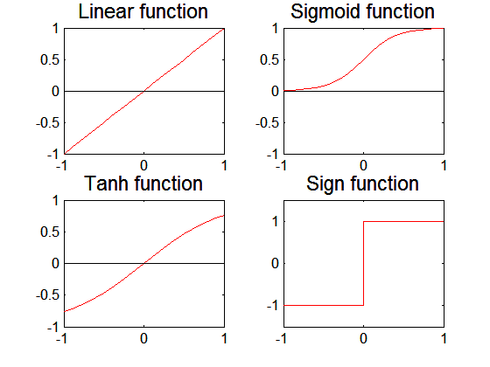
Artificial Neural Networks (ANN)
Various types of neural network topology
single-layered network (perceptron) versus multi-layered network
Feed-forward versus recurrent network
Various types of activation functions (f)
The perceptron is the simplest form of a neural network used for the classification of patterns said to be linearly separable.

Slide 12

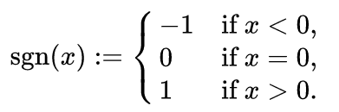
Artificial Neural Networks (ANN)
A sigmoid function is a mathematical function having a characteristic "S"-shaped curve or sigmoid curve. Often, sigmoid function refers to the special case of the logistic function shown in the first figure and defined by the formula
The sign function is an odd mathematical function that extracts the sign of a real number. In mathematical expressions the sign function is often represented as sgn.

Slide 13
Perceptron
Single layer network
Contains only input and output nodes
Activation function: f = sign(w.x)
Applying model is straightforward
X₁ = 1, X₂ = 0, X₃ =1 => y = sign(0.2) = 1

Slide 14
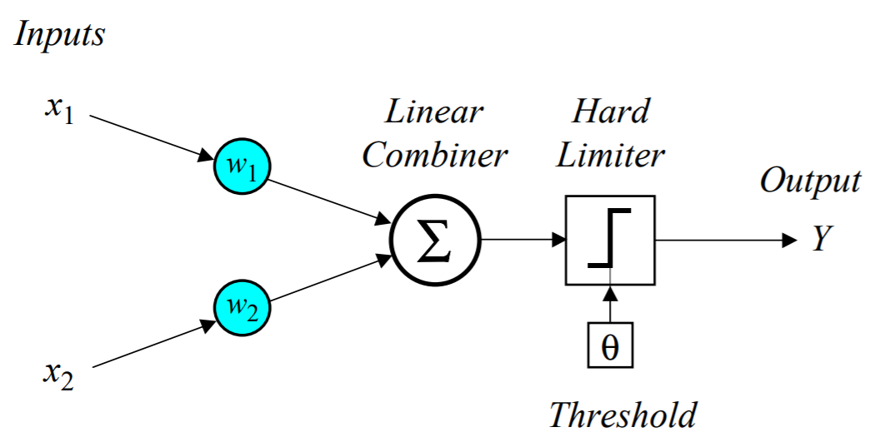
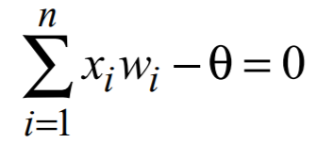
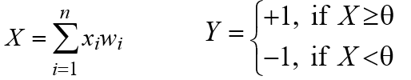
Single-layer two-input perceptron

Slide 15
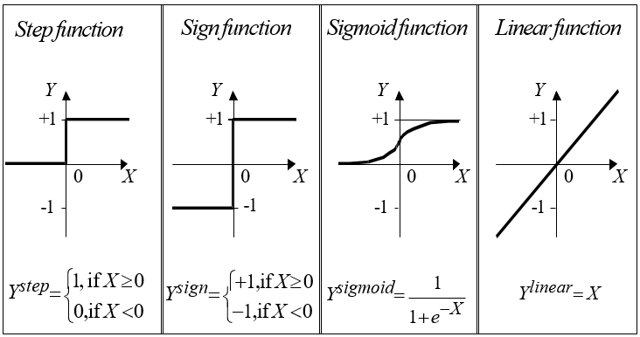
Activation functions of a Neuron

Slide 16
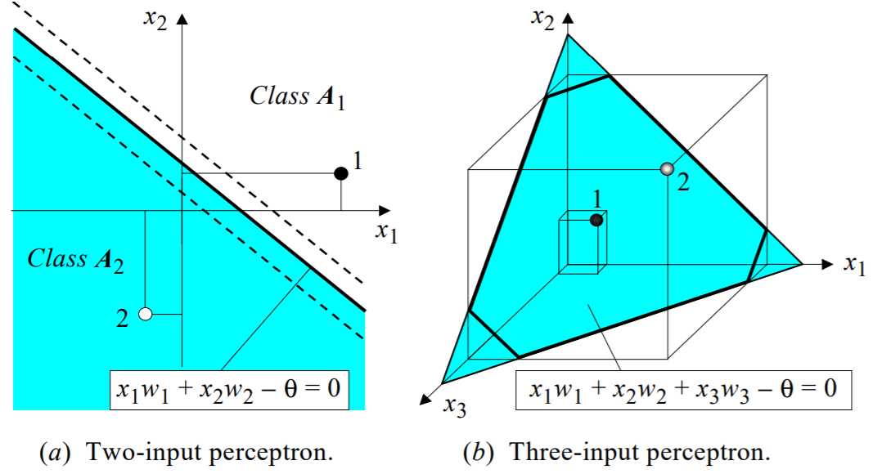
Linear separability in the perceptrons

Slide 17
How does the perceptron learn its classification tasks?
This is done by making small adjustments in the weights to reduce the difference between the actual and desired outputs of the perceptron.
The initial weights are randomly assigned, usually in the range [-0.5, 0.5], and then updated to obtain the output consistent with the training examples.

Slide 18

Error calculations
If at iteration p, the actual output is Y(p) and the desired output is Y_{d} (p), then the error is given by:
Iteration p here refers to the p^{th} training example presented to the perceptron.
If the error, e(p), is positive, we need to increase perceptron output Y(p), but if it is negative, we need to decrease Y(p).
where p = 1, 2, 3, . . .

Slide 19

The perceptron learning rule
where p = 1, 2, 3, . . .
α is the learning rate, a positive constant less than unity.
The perceptron learning rule was first proposed by Rosenblatt in 1960. Using this rule we can derive the perceptron training algorithm for classification tasks.

Slide 20
Perceptron’s training algorithm
Step 1: Initialisation
Set initial weights w1, w2,…, wn and threshold θ to random numbers in the range [-0.5, 0.5].
If the error, e(p), is positive, we need to increase perceptron output Y(p), but if it is negative, we need to decrease Y(p).

Slide 21

Perceptron’s training algorithm
Step 2: Activation
Activate the perceptron by applying inputs x1(p), x2(p),…, xn(p) and desired output Yd (p).
Calculate the actual output at iteration p = 1
where n is the number of the perceptron inputs, and step is a step activation function.

Slide 22


Perceptron’s training algorithm
Step 3: Weight training
Update the weights of the perceptron
Where Δwi(p) is the weight correction at iteration p.
The weight correction is computed by the delta rule:
Step 4: Iteration
Increase iteration p by one, go back to Step 2 and repeat the process until convergence.

Slide 23
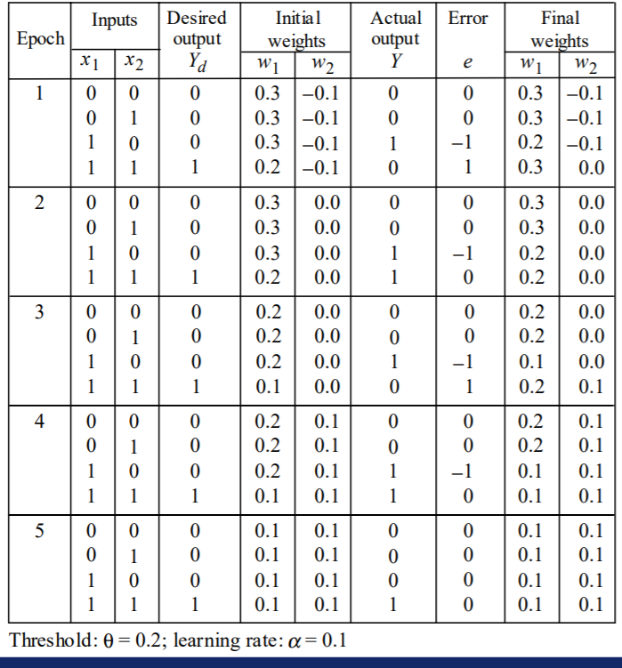
Example of perceptron learning: the logical operation AND
Notes:
X = 0 * 0.3 + 0 * -0.1 = 0, Y(actual) = step(0 – 0.2) = step(–0.2) = 0, error = 0 – 0 = 0
X = 0 * 0.3 + 1 * -0.1 = -0.1, Y(actual) = step(-0.1 – 0.2) = step(–0.3) = 0, error = 0 – 0 = 0
X = 1 * 0.3 + 0 * -0.1 = 0.3, Y(actual) = step(0.3 – 0.2) = step(0.1) = 1, error = 0 – 1 = -1
X = 1 * 0.2 + 1 * -0.1 = 0.1, Y(actual) = step(0.1 – 0.2) = step(-0.1) = 0, error = 1 – 0 = 1
Case 1: delta(W1) = 0.1 * (0) * 0 = 0, W1 = 0.3 + 0 = 0.3 , delta(W2) = 0.1 * (0) * 0 = 0, W2 = -0.1 + 0 = -0.1
Case 2: delta(W1) = 0.1 * (0) * 0 = 0, W1 = 0.3 + 0 = 0.3 , delta(W2) = 0.1 * (1) * 0 = 0, W2 = -0.1 + 0 = -0.1
Case 3: delta(W1) = 0.1 * (1) * -1 = -0.1, W1 = 0.3 – 0.1 = 0.2 , delta(W2) = 0.1 * (0) * -1 = 0, W2 = -0.1 – 0 = -0.1
Case 4: delta(W1) = 0.1 * (1) * 1 = 0.1, W1 = 0.2 + 0.1 = 0.3 , delta(W2) = 0.1 * (1) * 1 = 0.1, W2 = -0.1 + 0.1 = 0

Slide 24
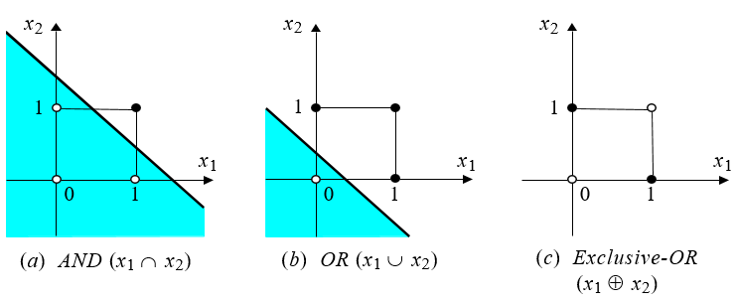
Two-dimensional plots of basic logical operations
A perceptron can learn the operations AND and OR, but not Exclusive-OR.

Slide 25
Nonlinearly Separable Data
XOR Data

Slide 26
Multilayer Neural Network
A multilayer perceptron is a feedforward neural network with one or more hidden layers.
The network consists of an input layer of source neurons, at least one middle or hidden layer of computational neurons, and an output layer of computational neurons.
The input signals are propagated in a forward direction on a layer-by-layer basis.

Slide 27
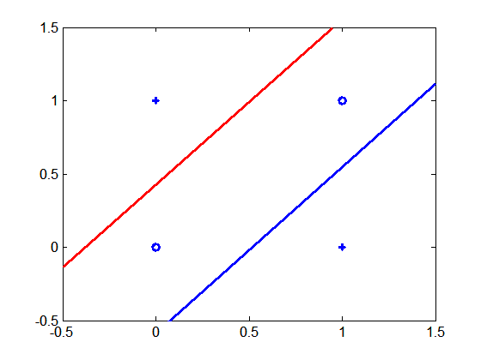
Multi-layer Neural Network
Multi-layer neural network can solve any type of classification task involving nonlinear decision surfaces
XOR Data

Slide 28
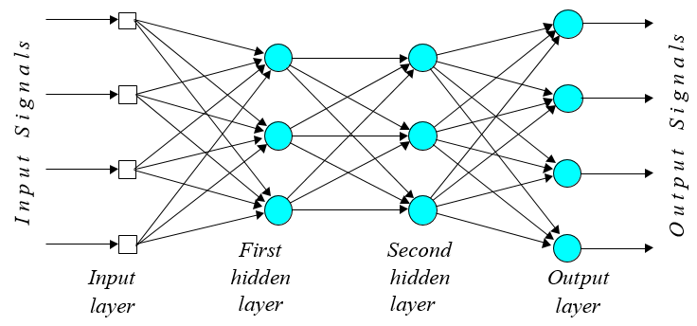
Multilayer perceptron with two hidden layers

Slide 29
What does the middle layer hide?
A hidden layer “hides” its desired output.
Neurons in the hidden layer cannot be observed through the input/output behaviour of the network. There is no obvious way to know what the desired output of the hidden layer should be.
Commercial ANNs incorporate three and sometimes four layers, including one or two hidden layers. Each layer can contain from 10 to 1000 neurons. Experimental neural networks may have five or even six layers, including three or four hidden layers, and utilise millions of neurons.

Slide 30
Learning Multi-layer Neural Network
Can we apply perceptron learning rule to each node, including hidden nodes?
Perceptron learning rule computes error term e = y - f(w,x) and updates weights accordingly
Problem: how to determine the true value of y for hidden nodes?
Approximate error in hidden nodes by error in the output nodes
Problem:
Not clear how adjustment in the hidden nodes affect overall error
No guarantee of convergence to optimal solution

Slide 31
Gradient Descent for Multilayer NN
Weight update:
Error function:
Activation function f must be differentiable
For sigmoid function:
Stochastic gradient descent (update the weight immediately)

Slide 32
Gradient Descent for MultiLayer NN
For output neurons, weight update formula is the same as before (gradient descent for perceptron)
For hidden neurons:

Slide 33
Design Issues in ANN
Number of nodes in input layer
One input node per binary/continuous attribute
k or log₂ k nodes for each categorical attribute with k values
Number of nodes in output layer
One output for binary class problem
k or log₂ k nodes for k-class problem
Number of nodes in hidden layer
Initial weights and biases

Slide 34
Characteristics of ANN
Multilayer ANN are universal approximators but could suffer from overfitting if the network is too large
Gradient descent may converge to local minimum
Model building can be very time consuming, but testing can be very fast
Can handle redundant attributes because weights are automatically learnt
Sensitive to noise in training data
Difficult to handle missing attributes

Slide 35
Recent Noteworthy Developments in ANN
Use in deep learning and unsupervised feature learning
Seek to automatically learn a good representation of the input from unlabeled data
Google Brain project
Learned the concept of a ‘cat’ by looking at unlabeled pictures from YouTube
One billion connection network

